Slide 1

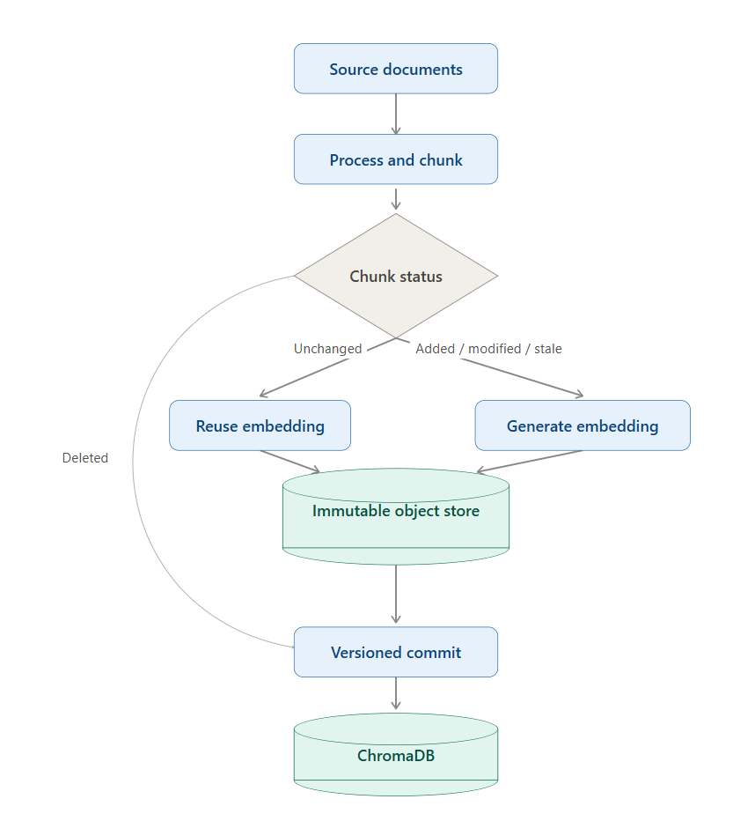
MIT SCHOOL OF COMPUTING
Class : TYAIA1 & CC1
Group Id: TYAIA116
DEPARTMENT OF COMPUTER SCIENCE & ENGINEERING
EmbeddingVC
Git-Inspired Version Control System for AI Embeddings
Adwait Tagalpallewar , Archit Bankey, Parth Verma, Sagar Shahgond
Faculty Guide: Dr. Naagesh Jadhav
SAYS | THINKS
"Updating all embeddings takes too much time." "I need a reliable way to track embedding changes." "Which embeddings are still valid?" "I want to restore previous embedding versions easily." | "Can I regenerate only the affected embeddings?" "How do I detect stale embeddings accurately?" "Will changing the embedding model break compatibility?" "There should be a Git-like system for embeddings."
Sr no. | Requirements | Proposed Solution
1. | Detect changed documents | SHA-256 hashing
2. | Track embedding versions | Git-like commits
3. | Avoid duplicate embeddings | Content-addressable storage
4. | Restore previous state | Checkout mechanism
5. | Fast updates | Incremental regeneration
6. | Detect stale vectors | Configuration hashing
7. | Scroll through old versions | Versioned vectors
8. | Track metadata | Provenance system
AI/ML Engineer
DOES | FEELS
Regenerates embedding collections after document changes. Updates vector databases manually. Compares document and embedding versions. Maintains metadata and configuration details. | Frustrated by long regeneration times. Worried about losing reproducibility. Unsure whether old embeddings are still valid. Needs a faster, more reliable version control system.
Problem statement
Modern AI systems such as RAG, semantic search, and vector databases rely on embeddings. When source documents, preprocessing, chunking, or embeddings models change, existing embeddings become outdated. Current system often regenerate the entire embedding collection, leading to high computational cost and longer processing time. Therefore, a Git-inspired version control system is needed to efficiently track embedding changes, reuse valid embeddings, and regenerate only the affected vectors.
Proposed Solution
EmbeddingVC introduces a Git-inspired version control framework for AI embeddings. The system tracks document changes, identifies stale embeddings using content and configuration hashes, incrementally regenerates only the affected vectors, and maintains version history with complete provenance. Instead of rebuilding the entire vector database after every modification, EmbeddingVC updates only the changed embeddings, reducing computational cost while improving reproducibility and retrieval consistency.
Scope and Feasibility
Support multimodal embeddings for text, images, audio, video.
Enable cross-model alignment and compatibility.
Develop collaborative version control for teams.
Integrate with cloud vector databases like Pinecone, Weaviate, and Qdrant.
Automate semantic drift detection between versions.
Provide visualization of embedding changes and history.

